Slide 1
AEM MSM. Rollout Configs

Slide 2
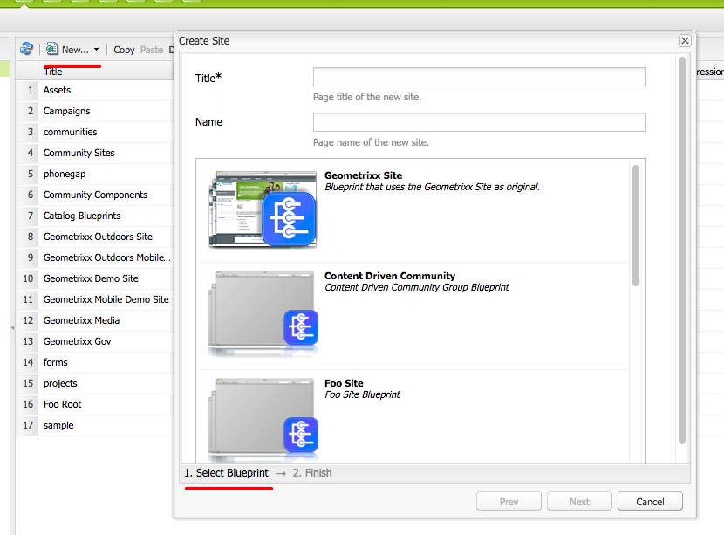
Have you ever created site in AEM?
To Create Site => Select Blueprint =>
Create Blueprint =>Select Site Root=>
Source Path => Create Site
http://localhost:4502/siteadmin#/content
http://localhost:4502/sites.html/content
http://localhost:4502/miscadmin#/etc/blueprints

Slide 3
Site != Website
The website set of page, with root page under content.
The immediate child pages of the root are language branches of the web site. The Name of each page is a language code. When creating a Live Copy, the languages are presented as optional content to include in the copy.
Each language page contains one or more child pages.

Slide 4
Create website and language copy
/content/AEMMinsk/en
/content/AEMMinsk/ru
/content/AEMMinsk/by -- ?
<language-code>_<country-code>
/libs/wcm/core/resources/languages

Slide 5
Live Copy
Can be created from any page/ or set of pages/or Blueprint
No strict requirements
Rollout config can be provided
A Live Copy can only be linked to one Blueprint.

Slide 6
Blueprint
Require center site structure as source
A Blueprint can be linked to several Live Copies
Blueprint control center
http://localhost:4502/miscadmin#/etc/blueprints
http://localhost:4502/etc/blueprints.html

Slide 7
API
LiveRelationshipManager
getLiveRelationships - Find all LiveRelationships, that have the given Resource as Blueprint. The result can be filtered to match a branch with giving a target filter and further an optional filter for the Trigger. The result is a RangeIterator that contains the matching LiveRelationships.
LiveRelationship
Defines a live relationship of a synced resource between its blueprint and livecopy. for example, if a site (blueprint) "/content/geometrixx" has a livecopy in "/content/copy", then the resource of "/content/geometrixx/en/jcr:content" and "/content/copy/en/jcr:content" form a relationship. This is also extensible for components within a page, for example the "/content/geometrixx/en/jcr:content/par/title" and "/content/copy/en/jcr:content/par/title" can form a relationship.
https://docs.adobe.com/docs/en/aem/6-0/develop/ref/javadoc/com/day/cq/wcm/msm/api/LiveRelationshipManager.html

Slide 8
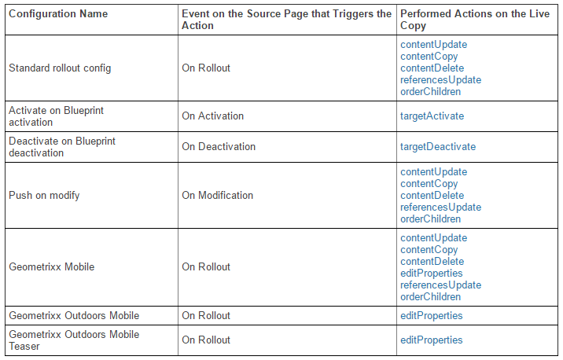
RolloutConfigs

Slide 9
Custom Rollout Config
Create
http://localhost:4502/miscadmin#/etc/msm/rolloutconfigs
Edit
http://localhost:4502/crx/de/index.jsp#/etc/msm/rolloutconfigs

